Slide 1
Computing PageRank using MapReduce
Jasper Snoek
CSC2544 Final Project Report
Dec. 2008

Slide 2
Motivation
The internet is huge: Google has found over 1 trillion unique urls¹!
Assume each url takes 0.5K, then we need over 400TB just to store URLs!
Need an algorithm to rank webpages based on importance efficiently: PageRank
Need a framework that allows the implementation PageRank in a distributed and highly scalable way: MapReduce

Slide 3
PageRank
The ranking of a page is determined by its estimated importance (determined by link structure) instead of by its content.
Sergey Brin and Lawrence Page (1998). "The anatomy of a large-scale hypertextual Web search engine". Proceedings of the seventh international conference on World Wide Web 7: 107-117
Page, Lawrence; Brin, Sergey; Motwani, Rajeev and Winograd, Terry (1999). The PageRank citation ranking: Bringing order to the Web

Slide 4
MapReduce
“A programming model and associated implementation for processing and generating large data sets.” -J. Dean and S. Ghemawat, MapReduce: Simplified Data Processing on Large Clusters. OSDI, 2004
Many algorithms can be decomposed into two stages: 1) A map stage that maps a key/value pair into intermediate sets of key/value pairs. 2) A reduce stage that merges all of the values associated with the same key.
Each stage is implemented as a separate function call for each key (running on a different thread, processor, or computer)‏

Slide 5
Computing PageRank using MapReduce
Parse documents (web pages) for links
Iteratively compute PageRank
Sort the documents by PageRank
Web
Pages
Parse
Links
Compute
PageRank
Iterate
until
convergence
...
Sort by
PageRank
Create
Index

Slide 6
Step 1: Parse URLs
Map:
Input: index.html
<html><body>Blah blah blah... <a href=“2.html”>A link</a>....</html>
Output for each out link:
key: “index.html”
value: “2.html”
Reduce:
Input:
key: “index.html”
values: “2.html”, “3.html”, ...
Output:
key: “index.html”
Value: “1.0 2.html 3.html ...”
Start with a bunch of documents. Invoke a new Map call for each large chunk of a document.

Slide 7
Step 1: Parse URLs
Map:
Input: index.html
<html><body>Blah blah blah... <a href=“2.html”>A link</a>....</html>
Output for each out link:
key: “index.html”
value: “2.html”
Reduce:
Input:
key: “index.html”
values: “2.html”, “3.html”, ...
Output:
key: “index.html”
Value: “1.0 2.html 3.html ...”
For each link found, output the id (url) of the document as the key and the link as the value.

Slide 8
Step 1: Parse URLs
Map:
Input: index.html
<html><body>Blah blah blah... <a href=“2.html”>A link</a>....</html>
Output for each out link:
key: “index.html”
value: “2.html”
Reduce:
Input:
key: “index.html”
values: “2.html”, “3.html”, ...
Output:
key: “index.html”
Value: “1.0 2.html 3.html ...”
The reducer simply appends all the outlinks from a single document to a string and outputs <docid> <outlinks>

Slide 9
Step 1: Parse URLs
Map:
Input: index.html
<html><body>Blah blah blah... <a href=“2.html”>A link</a>....</html>
Output for each out link:
key: “index.html”
value: “2.html”
Reduce:
Input:
key: “index.html”
values: “2.html”, “3.html”, ...
Output:
key: “index.html”
Value: “1.0 2.html 3.html ...”
We'll also assign an initial PageRank here. Start with a uniform PageRank for all pages.

Slide 10
Step 2: Page Rank Iterations
Map:
Input:
key: index.html
value: <pagerank> 1.html 2.html...
Output for each outlink:
key: “1.html”
value: “index.html <pagerank> <number of outlinks>”
Reduce
Input:
Key: “1.html”
Value: “index.html 0.5 23” Value: “2.html 2.4 2” Value: ...
Output:
Key: “1.html”
Value: “<new pagerank> 1.html 2.html...”
Start with the initial pagerank and outlinks of a document.

Slide 11
Step 2: Page Rank Iterations
Map:
Input:
key: index.html
value: <pagerank> 1.html 2.html...
Output for each outlink:
key: “1.html”
value: “index.html <pagerank> <number of outlinks>”
Reduce
Input:
Key: “1.html”
Value: “index.html 0.5 23” Value: “2.html 2.4 2” Value: ...
Output:
Key: “1.html”
Value: “<new pagerank> 1.html 2.html...”
For each outlink, output the docid of this document, its PageRank, and its total number of outlinks.

Slide 12
Step 2: Page Rank Iterations
Map:
Input:
key: index.html
value: <pagerank> 1.html 2.html...
Output for each outlink:
key: “1.html”
value: “index.html <pagerank> <number of outlinks>”
Reduce
Input:
Key: “1.html”
Value: “index.html 0.5 23” Value: “2.html 2.4 2” Value: ...
Output:
Key: “1.html”
Value: “<new pagerank> 1.html 2.html...”
Now the reducer has a document id, all the inlinks to that document and their corresponding PageRanks and number of outlinks.

Slide 13
Step 2: Page Rank Iterations
Map:
Input:
key: index.html
value: <pagerank> 1.html 2.html...
Output for each outlink:
key: “1.html”
value: “index.html <pagerank> <number of outlinks>”
Reduce
Input:
Key: “1.html”
Value: “index.html 0.5 23” Value: “2.html 2.4 2” Value: ...
Output:
Key: “1.html”
Value: “<new pagerank> 1.html 2.html...”
Compute the new PageRank and output in the same format as the URL parser.

Slide 14
Step 2: Page Rank Iterations
Map:
Input:
key: index.html
value: <pagerank> 1.html 2.html...
Output for each outlink:
key: “1.html”
value: “index.html <pagerank> <number of outlinks>”
Reduce
Input:
Key: “1.html”
Value: “index.html 0.5 23” Value: “2.html 2.4 2” Value: ...
Output:
Key: “1.html”
Value: “<new pagerank> 1.html 2.html...”
Now iterate until convergence!
Note: even computing convergence can be tricky when the computation is distributed.

Slide 15

Step 2: Computing PageRank
PageRank of document v
that links to u
1 – damping factor
PageRank of document u
Damping
factor
Number of outlinks from document v

Slide 16
Step 2: Computing PageRank
PageRank of document v
that links to u
1 – damping factor
PageRank of document u
Damping
factor
Number of outlinks from document v
Remember the reducer gets for each document v linking to u:
Key: “u”
Value: “v <PageRank of v> <number of outlinks from v>”
So we just sum over all the values passed to the reducer to compute the new PageRank!

Slide 17
Step 3: Sort Documents by PageRank
Last step:
Sort all the documents by pagerank
Assume many gigabytes of document ids, PageRanks and outlinks.
MapReduce sorts all outputs by key using a distributed mergesort (very fast and scalable)‏
Sort the outputs from each reduce and then merge them to a file.
So output pagerank as key, document id as value and MapReduce takes care of the rest.
Map:
Input:
Key: “index.html”
Value: “<pagerank> <outlinks>”
Output:
Key: “<pagerank>”
Value: “index.html”

Slide 18

Implementation Details
Hadoop Open-Source MapReduce Framework
Java built on Apache
Used by Yahoo, Amazon
No cluster – just my (dual-core) laptop :(

Slide 19
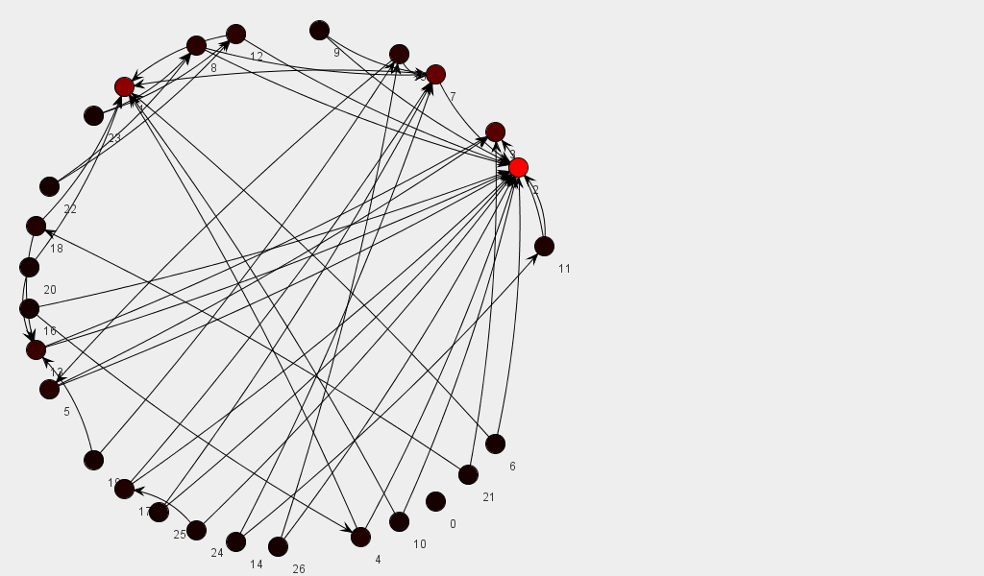
Testing the Algorithm
Create a synthetic web graph
JUNG (Java Universal Network/Graph) Framework
Open source Java library for modeling and viewing graphs
Generate random (semi-realistic) graphs and compute PageRank!
Note: I skipped the URL parsing stage here...

Slide 20
Testing the Algorithm: (Preferential Attachments)‏
Adding new vertices to the graph:
A.-L. Barabasi and R. Albert, Emergence of scaling in random networks, Science 286, 1999.
Create a new vertex and create n out-edges. Choose the targets of the out-edges with probability proportional to the in-degree of the target.
Probability of adding an edge from a newly generated vertex to an existing vertex v: p = (in-degree(v) + 1) / (|E| + |V|) where |E| and |V| are the number of edges and vertices respectively.

Slide 21
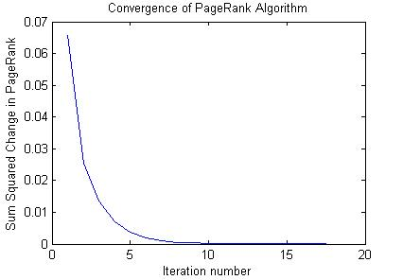
Testing the Algorithm
The PageRank algorithm converges rapidly for any sized web-graph. This figure shows the convergence for a graph of 1000 vertices (with an average of two links per vertex). Brin and Page report that PageRank computation for a webgraph of 322 million links converges in only 52 iterations. (Page, Lawrence; Brin, Sergey; Motwani, Rajeev and Winograd, Terry (1999). The PageRank citation ranking: Bringing order to the Web)

Slide 22
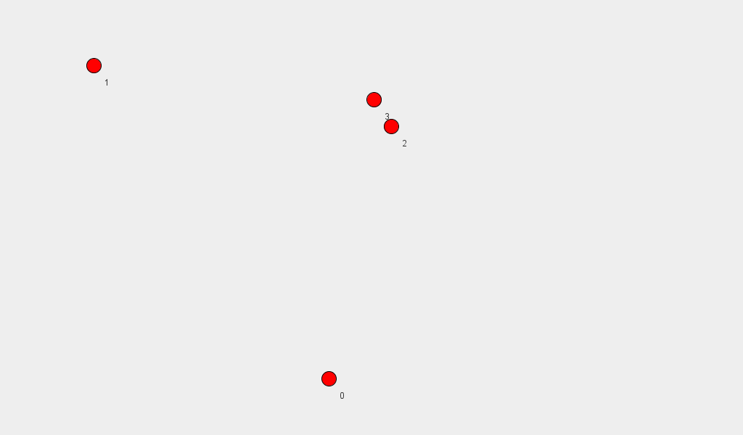
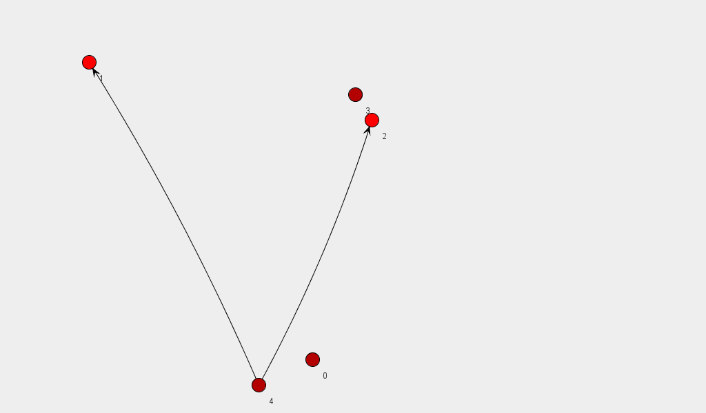
Generating a new graph
Add a new vertex with 2 links (targets are decided by the preferential attachment model)
(Vertices are colored by their relative PageRanks)
Start with a set of vertices

Slide 23
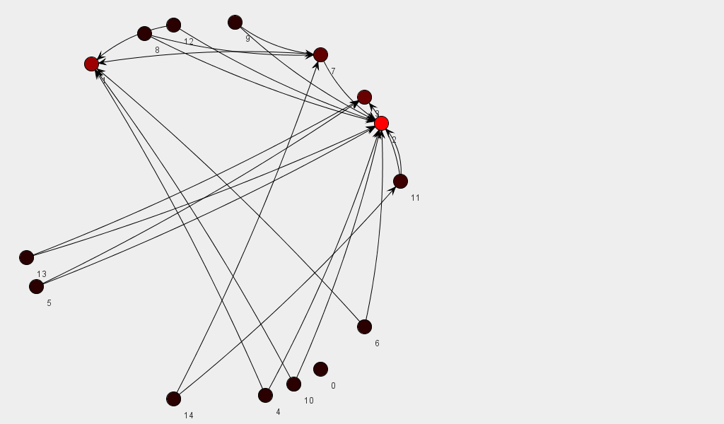
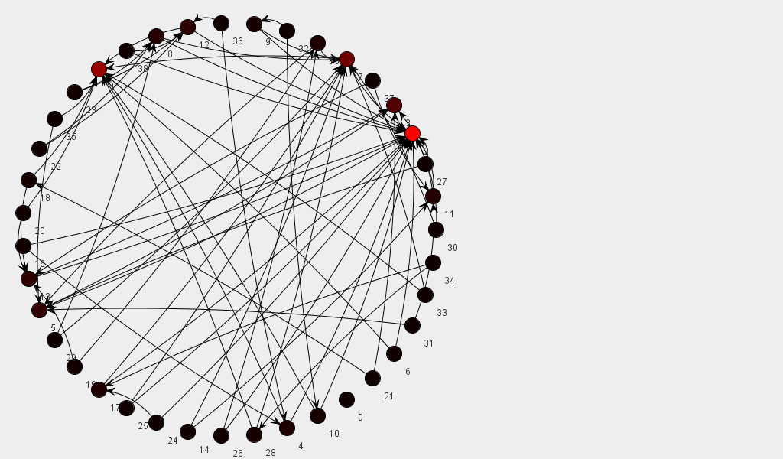
Generating a graph
After adding 10 new vertices
After adding 35 new vertices
The vertex with highest indegree gets the highest pagerank

Slide 24
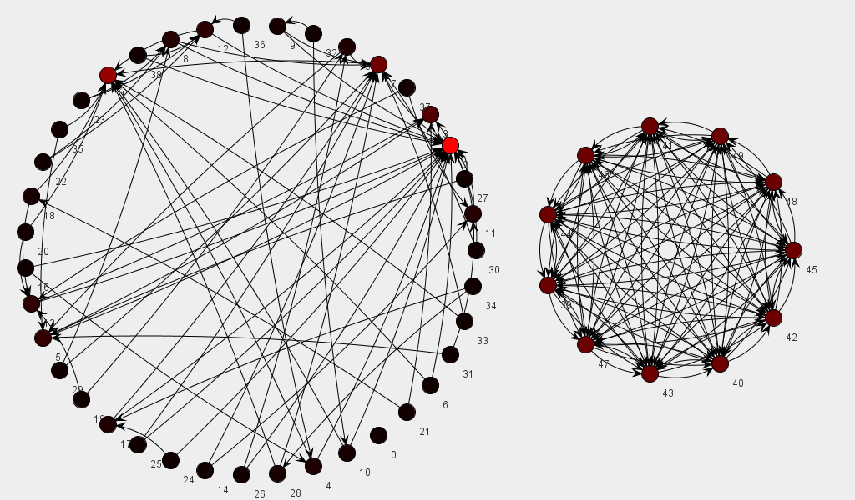
Someone created a densely connected spam network
The spam pages manage to obtain substantial PageRank but not as much as the legitimate page

Slide 25
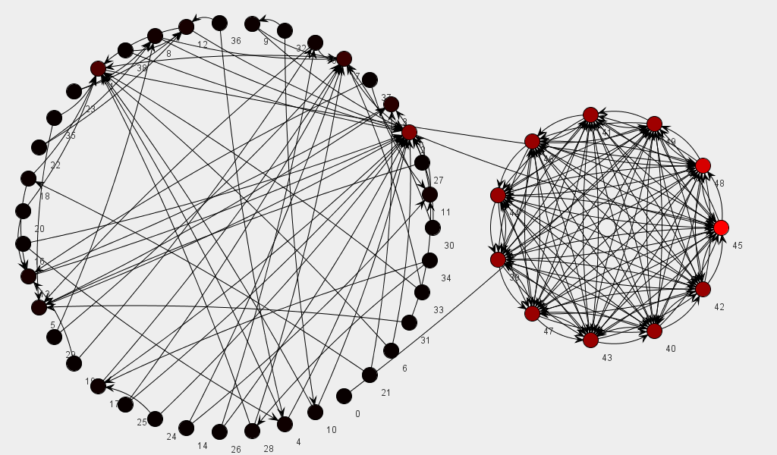
Now they hijacked a couple of web sites and added links to their spam sites!
With the additional links from highly ranked sites, the PageRank of the spam sites dominates, even though their indegree has not changed significantly.

Slide 26
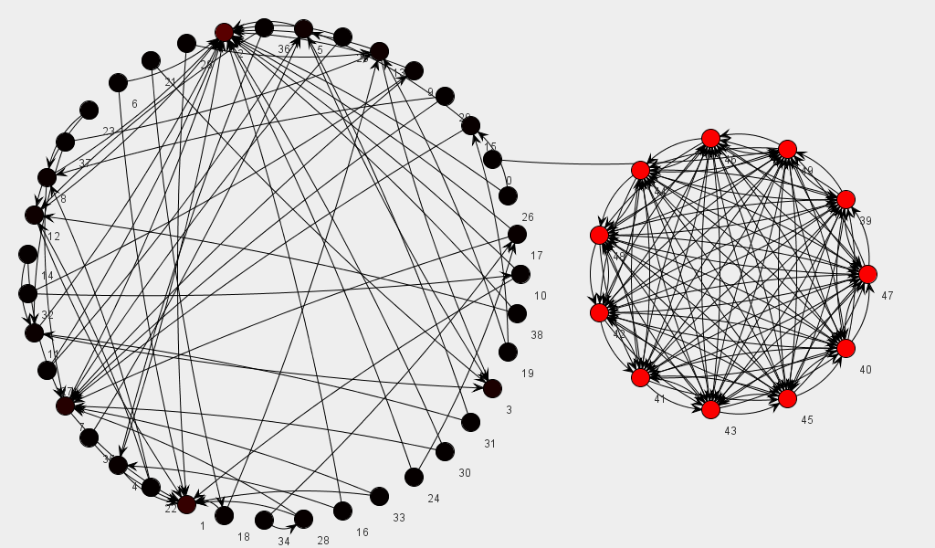
What if there’s no decay term?
Now the densely connected sub-graph acts as a rank sink. The random-surfer model now doesn’t teleport a surfer out of the sub-graph, essentially getting them stuck.

Slide 27
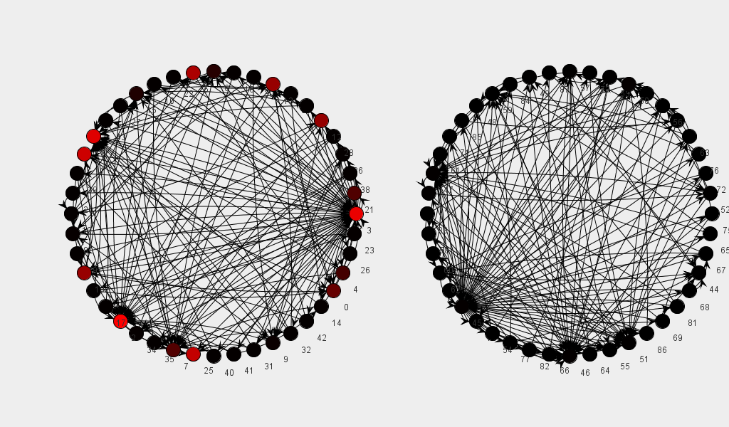
Topic-Based PageRank
This graph simulates two sub-graphs with identical link structure. However, only one of the subgraphs has pages that have been designated as authority pages.
Topic-Authorities
Topic-Authorities
T. Haveliwala. Topic-sensitive pagerank: A context-sensitive ranking algorithm for web search. (2003) IEEE Transactions on Knowledge and Data Engineering

Slide 28
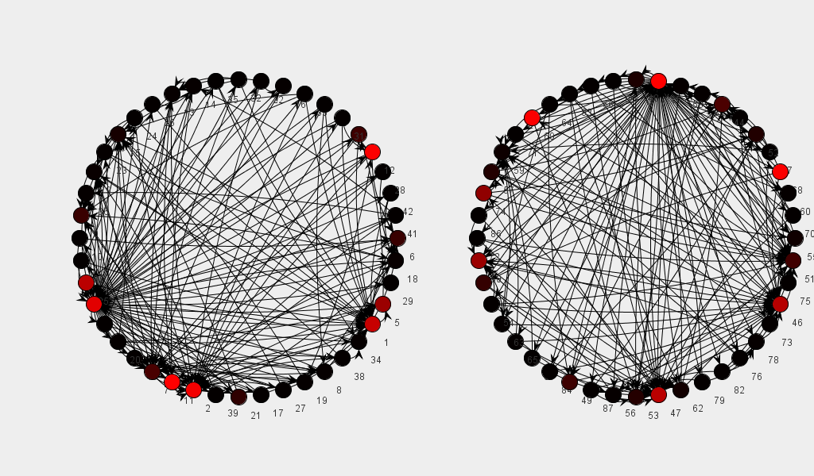
Topic-Based PageRank
Now both sub-graphs have topic authorities. Thus they both have sites that have substantial PageRank.
Topic-Authority
Topic-Authority
Topic-Authority
Topic-Authority
T. Haveliwala. Topic-sensitive pagerank: A context-sensitive ranking algorithm for web search. (2003) IEEE Transactions on Knowledge and Data Engineering

Slide 29
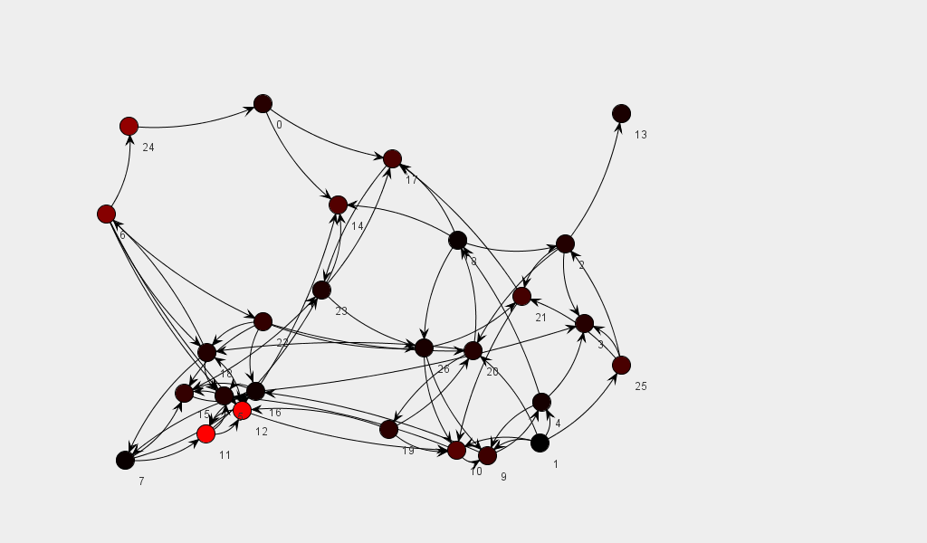
A Randomly Connected Graph
Interestingly, the distribution of PageRanks still appears to follow a power law, even when vertices are linked together completely randomly.

Slide 30
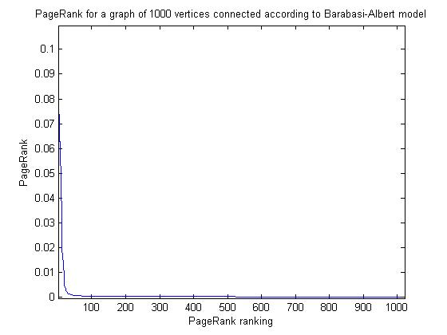
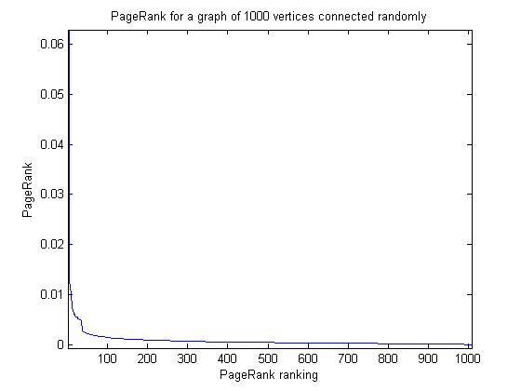
Distribution of PageRank
The distribution of PageRank for a graph where edges are connected according to the Barabasi-Albert model between 1000 vertices.
The distribution of PageRank for a graph where edges are connected randomly between 1000 vertices.
The distribution of PageRank closely resembles a power law with an exponent of approx. -1 as is reported in (N. Litvak, W. Scheinhardt and Y. Volkovich. Probabilistic Relation between In-Degree and PageRank). It is interesting that the distributions are similar for a randomly connected graph as well as a graph connected according to the Barabasi-Albert model. However, clearly the Barabasi-Albert model has a larger (i.e. more negative exponent).

